Slide 1

SIX1015 Science, Technology and Society Semester 2 2025/2026
Week 5 - Part 2: Science, Technology and Sustainable Futures

Slide 2
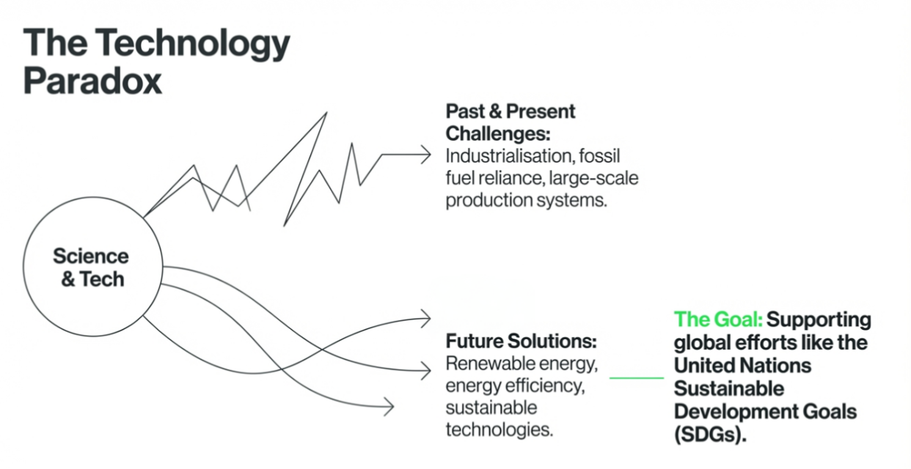

Slide 3
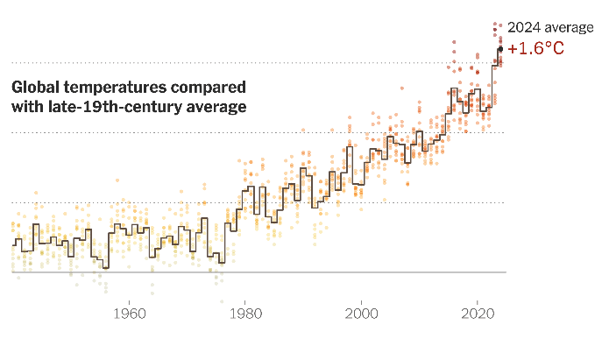
Climate urgency
Climate change is driven largely by human activities, especially through energy use and emissions.
According to assessments by the Intergovernmental Panel on Climate Change, limiting global warming to around 1.5°C above the preindustrial level is important to reduce the severity of climate impacts.
Increasing temperatures are associated with more extreme weather events, environmental degradation impacts on livelihoods and ecosystems.
https://www.nytimes.com/interactive/2025/01/09/climate/2024-heat-record-climate-goal.html

Slide 4
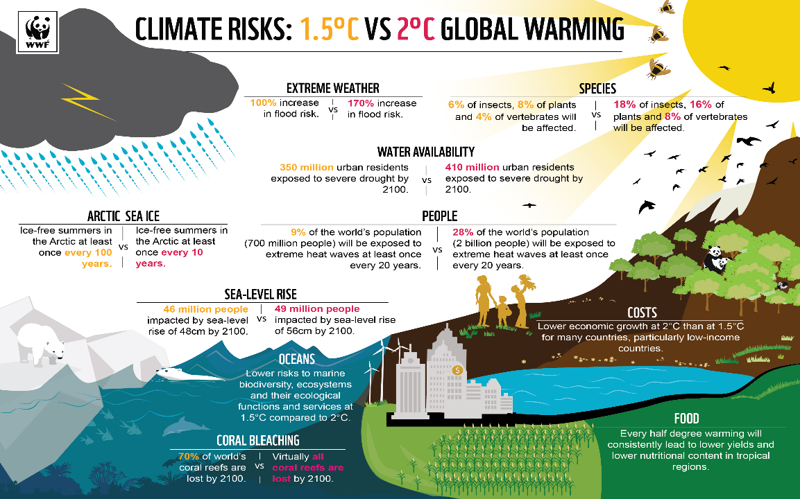

Slide 5
Achieving Net Zero by 2050
In response to climate urgency, countries have committed to climate action through international processes such as the Paris Agreement.
These commitments are discussed and reviewed in ongoing global meetings known as Conference of the Parties (COP).
Within this context, many countries set targets related to Net Zero emissions.
Net Zero refers to:
- reducing greenhouse gas emissions as much as possible
balancing remaining emissions through removal or offset
Please watch this video: https://www.youtube.com/watch?v=k24cAkeQWx4

Slide 6
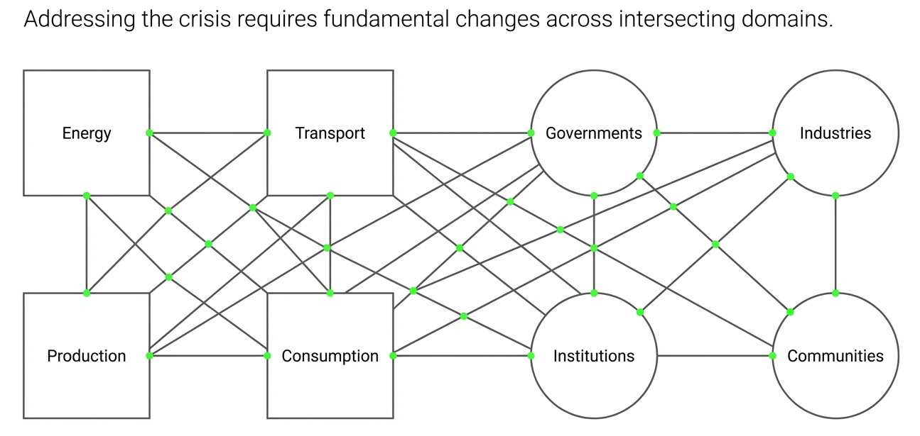

Slide 7
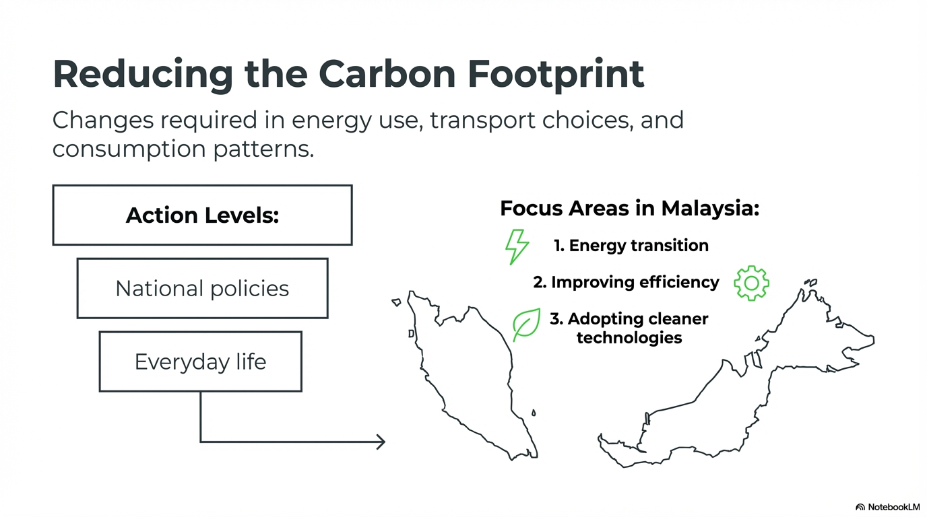

Slide 8
When deciding how to achieve sustainability, we often need to balance different values:
Environmental protection vs economic development
→ reducing emissions may limit industrial growth
Fairness vs efficiency
→ the most efficient solution may not be the most equitable
Short-term needs vs long-term outcomes
→ immediate benefits may conflict with future sustainability

Slide 9
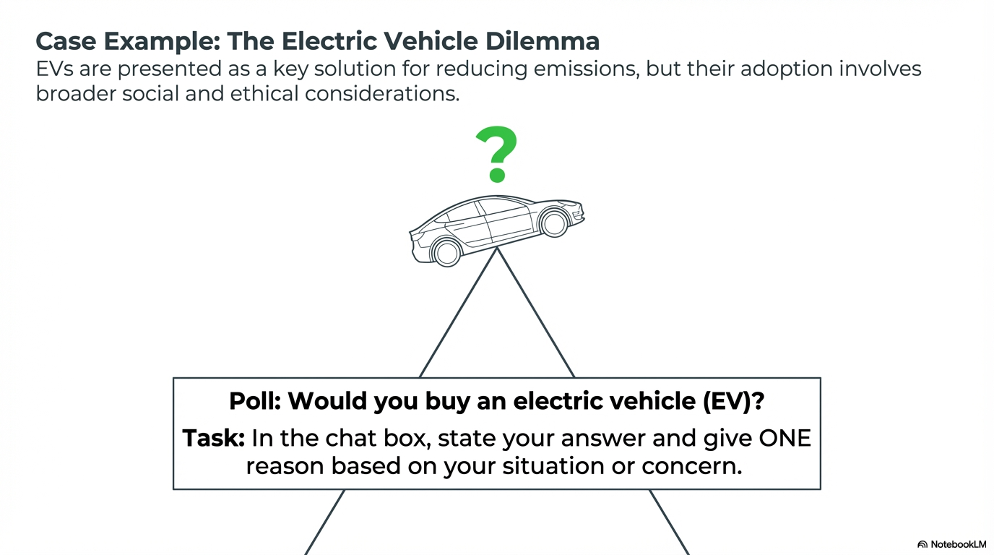

Slide 10
Ethical principles in sustainability
Beneficence: Sustainability solutions should aim to produce overall benefits for society and the environment
Non-maleficence: Potential harms and risks should be identified and minimized
Shared responsibility: Sustainability challenges require coordinated action across multiple stakeholders
Intergenerational justice: decisions today should consider the impacts on future generations
Equity: sustainability efforts should consider differences in access, resources, and capacity across groups

Slide 11
Key takeaways
Sustainability is not only about finding solutions.
It involves:
  balancing different values
  considering impacts on different groups
  making decisions under real-world constraints
There is often no perfect solution, only more thoughtful and responsible choices

Slide 12
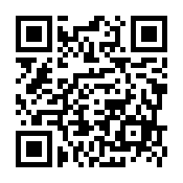
Post-survey
We received 267 responses for pre-survey on 30 March 2026.
To those who answered the pre-survey, please complete this post-survey no later than Friday 10 April 2026:
Scan this QR code:

